Slide 1



New Asynchronous AS4 Web Services Option for XCA, XCPD, XDR and XCDR Profiles
Presented by Charles Parisot GE Healthcare, IHE ITI Technical Committee Member,
IHE Intl Board Member

Slide 2
Interest of Asynchronous AS4 Web Services
To support scaling of document sharing between communities to a large numbers of gateways, Asynchronous Web Services Exchange is critical to realize a more efficient handling of latency and scale.
Asynchronous Web Services with AS4 relies on the OASIS AS4 WS Stack that has been natively designed to support Asynchronous WS exchange and offers:
Message packaging governed by ebMS 3.0 and message security governed by WS-Security
Support for both push and pull message exchange choreographies
Optional Payload compression
Non-Repudiation of Origin and Receipt
Reception Awareness – simple and effective reliable messaging with no known interoperability issues
2

Slide 3
Approach to the Asynchronous AS4 Web Services Option
A new Supplement issued by the IHE IT Infrastructure Committee in August 2018, which introduces:
An option to the profiles where the current WS-Addressing based Asynchronous WS Exchange is currently available:
XCA: Cross Community Access for sharing documents
XCPD Cross Community Patient Discovery
A new option to the XDR and XCDR Profiles, where the ITI-41 is specified to support Asynchronous WS, but the option is not explicitly stated as an Option.
An alternative to the current WS-Addressing based Asynchronous Option
.
3

Slide 4
Main Features of Asynchronous AS4
Based on pre-defined AS4 Conformance Profiles:
ebHandler (messaging client and server), or
Light Client (messaging client only)
Security
Signing and encryption using WS-Security, XML Signature, XML Encryption
IHE leaves details (algorithms etc.) to projects
Reliable Messaging
AS4 reception awareness (receipts, retries, duplicate elimination)
Error Handling and Receipt Handling
For push, profiled to use synchronous errors/receipts
4

Slide 5
AS4 Message Exchange Patterns (MEP)
Two Way MEP, reflect the fact that IHE transactions typically follow Request / Response pattern
Potential future use of One Way MEP (IHE DSUB profile)
In a MEP, each leg may be configured to use Push or Pull binding
Current IHE stack uses Push for request, response on backchannel
Pull feature helps address network connectivity constraints (firewalls policies) on incoming connections; known problem for projects willing to use current (WS-Addressing) asynchronous exchanges based on the IHE technical framework
For (evolutions of) implementations of current IHE stack, Push-and-Push MEP likely initial target
Push-and-Pull, Pull-and-Push new alternative opportunities
5

Slide 6
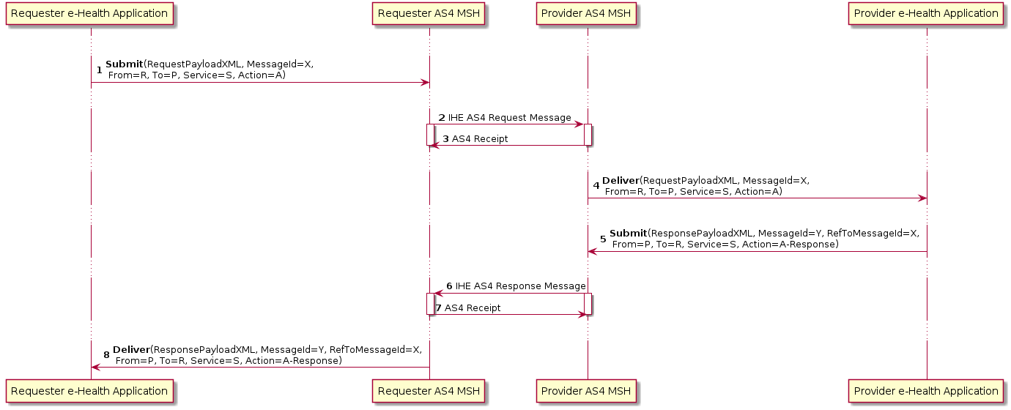
Two Way Push-and-Push Message Exchange Pattern
6

Slide 7
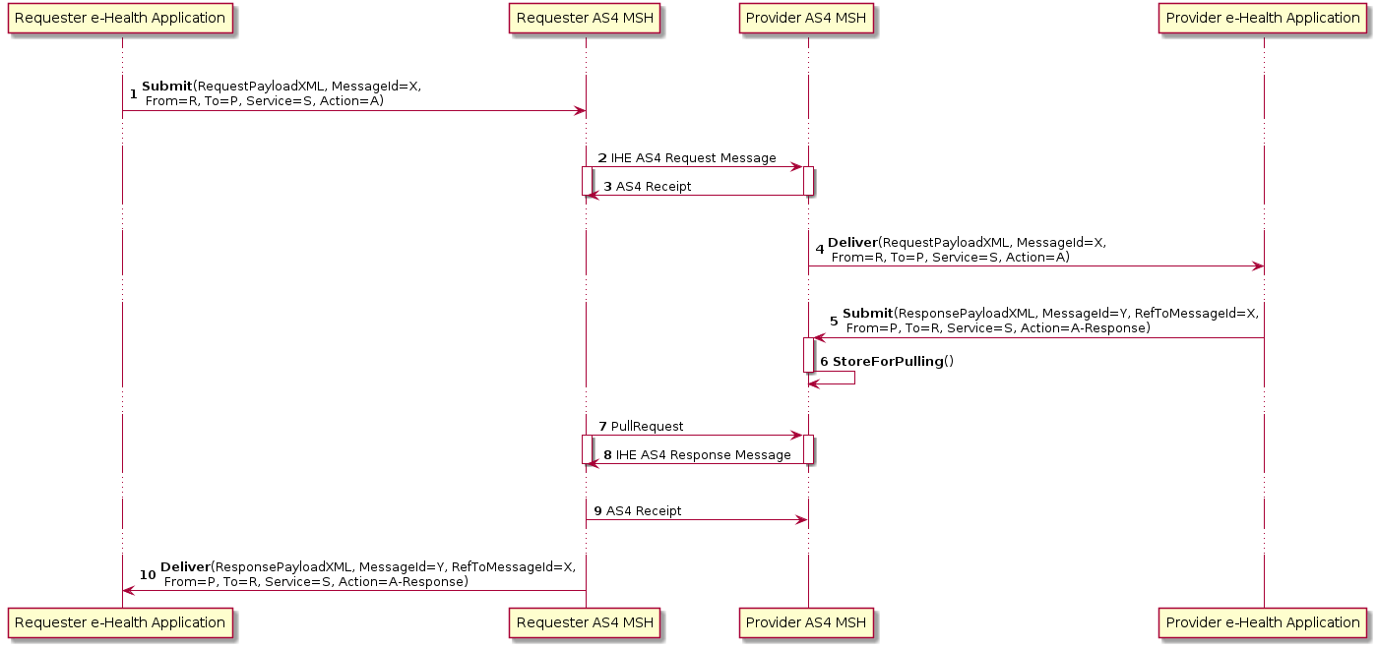
Alternative Two Way Push-and-Pull Message Exchange Pattern

Slide 8
Packaging
Request and Response XML content is carried in SOAP 1.2 Body
As in current IHE WS-Addressing based synchronous stack
Avoids many changes in IHE Technical Framework documentation and therefore preferred to stimulate adoption
Use or non-use of MIME is profiled per transaction:
SOAP-with-Attachment MIME envelope for transactions involving binary “documents”
Simple SOAP 1.2 envelopes (no packaging of SOAP envelope in a root MIME part) for transactions involving only XML request or response
Transactions involving documents in attachments involve cross-references from XML request/response to documents. It is done two ways:
Use of Part properties in AS4 PayloadInfo is the clean, native AS4 approach
Use of “xop:Include” and “xds:Document” is redundantly required to ease migration/adoption of existing IHE products.
8

Slide 9
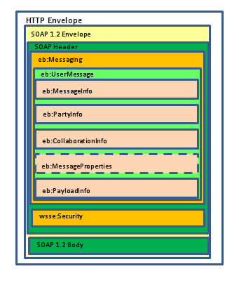
Simple SOAP 1.2 Packaging
Used for transactions that do not involve (binary) “documents”, but only contain an XML request or request
Simple SOAP 1.2 packaging, no use of Multipart/Related MIME Envelope
XML request or response is contained in SOAP Body, as in current IHE stack

Slide 10
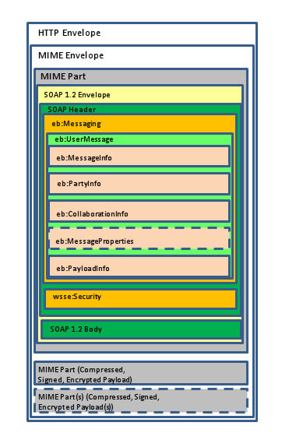
SOAP-with-Attachments Packaging
Used for IHE transactions in which binary payloads (“documents”) are exchanged together with, but separate from, XML request or response
Cross Gateway Retrieve [ITI-39]
Provide and Register Document Set-b [ITI-41]
Retrieve Document Set [ITI-43]
Cross-Gateway Document Provide [ITI-80]
SOAP envelope containing eb:Messaging header is in the SOAP root part of a Multipart/Related MIME envelope
Binary documents are in natively compressed formats, no need for additional compression
SWA replaces MTOM packaging in current IHE stack
XML request or response is contained in SOAP Body, as in current IHE stack

Slide 11
Associating AS4 Payloads to Metadata
<eb:PayloadInfo> <eb:PartInfo> <!-- The first part is the XML XDS-b ProvideAndRegisterDocumentSetRequest document. Absence of an @href indicates the content is in the SOAP Body. --> </eb:PartInfo> <eb:PartInfo href="cid:0e3f6331-b5a8-4758-8cfd-c562d2ea1c86@requester.ro" > <!-- the first document in the package (PDF) --> <eb:PartProperties> <eb:Property name="id">Document01</eb:Property> </eb:PartProperties> </eb:PartInfo> <eb:PartInfo href="cid:9cf5c59a-068c-4c4d-a3ed-a24becee643f@requester.ro" > <!-- the second document in the package (JPEG) --> <eb:PartProperties> <eb:Property name="id">Document02</eb:Property> </eb:PartProperties> </eb:PartInfo> </eb:PayloadInfo>
<env:Body> <xdsb:ProvideAndRegisterDocumentSetRequest xmlns:xdsb="urn:ihe:iti:xds-b:2007"> <lcm:SubmitObjectsRequest> <rim:RegistryObjectList> <!-- details omitted --> <rim:ExtrinsicObject id="Document01"> <!-- details omitted --> </rim:ExtrinsicObject> <rim:ExtrinsicObject id="Document02"> <!-- details omitted --> </rim:ExtrinsicObject> </rim:RegistryObjectList> </lcm:SubmitObjectsRequest> <xdsb:Document id="Document01"><xop:Include href="cid:0e3f6331-b5a8-4758-8cfd-c562d2ea1c86@requester.ro"/> </xdsb:Document> <xdsb:Document id="Document02"><xop:Include href="cid:9cf5c59a-068c-4c4d-a3ed-a24becee643f@requester.ro"/> </xdsb:Document> </xdsb:ProvideAndRegisterDocumentSetRequest> </env:Body>
11

Slide 12
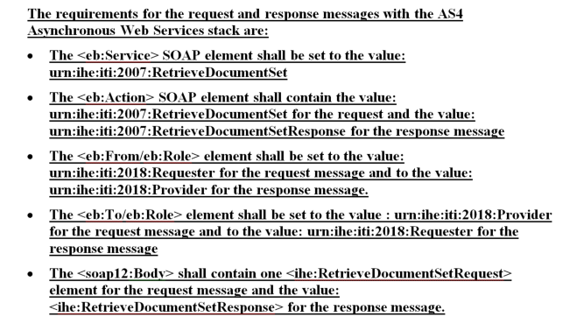
Transaction Specific Profiling (1)
Per transaction, for the request and the response, values are specified for:
Service
Action
From/Role
To/Role
For Service and Request action, by convention, the same values are used as for wsa:Action in current stack
The Response action is the same as Request action, with Response appended
Resulted in a large number of changes to technical framework, but the changes are predictable as they all follow the same pattern
12

Slide 13
IHE Trial Implementation Process
The Supplement: “Asynchronous AS4 Web Services Option” was developed by the IHE IT Infrastructure Committee between October 2017 and July 2018.
It is now in Trial implementation and is publicly available from the www.IHE.net website: (https://www.ihe.net/uploadedFiles/Documents/ITI/IHE_ITI_Suppl_AsyncAS4Option.pdf)
Groupable with other profiles (e.g., XUA, DSG). Designed to not disrupt existing architectures
The work item was used as an opportunity to re-document outdated text in the technical framework (Redocumented Appendix V in Volume 2.X of the ITI Technical Framework)
The AS4 Supplement will be tested at the 2019 Connectathons in North America (January 2019) and Europe (April 2019).
13

Slide 14
Questions

